Slide 2
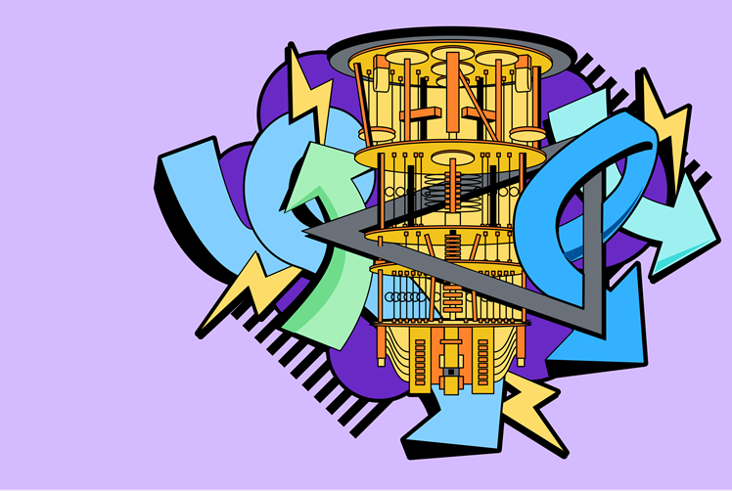
The Quantum Circuit Model
Harshit Gupta
IBM Qiskit Advocate
BTech. COE, NSUT
Notes:
Today our lecture would comprise of two parts -
The quantum circuit model - what is it composed of and how are quantum systems translated into it
Qiskit - we'll be diving deeper into the concepts of qiskit and see how it helps users to build their own quantum circuits, and much more
Let's get started

Slide 3
The Circuit Model
States
Quantum
Circuit
Measurements
Gates
Notes:
So the quantum circuit model is a way to model unitary quantum systems
It is broadly comprising of 3 parts i.e. States, gates and measurements.
Let's dissect them one by one -

Slide 4
States and Qubits
The way we represent a quantum system
Represented as wires
Notes:
You studied about the vectors and the bra ket notation in previous lectures given by Vardaan.
All those notations are used to model quantum states mathematically.
Translating that to our quantum circuit model, states,here, are modelled by horizontal wires

Slide 5
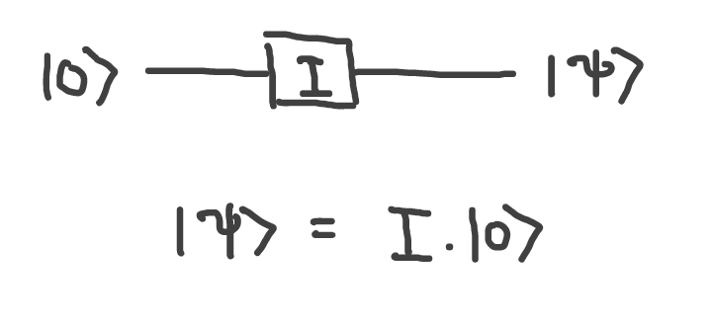
Starting Simple
Notes:
What you see on the screen is the simplest quantum system but great for understanding
We have a horizontal wire representing a freshly initialized qubit. This qubit is then acted on by an identity to produce the quantum state Psi
Although this is not very interesting, it still is enough to highlight the concepts i.e.

Slide 6
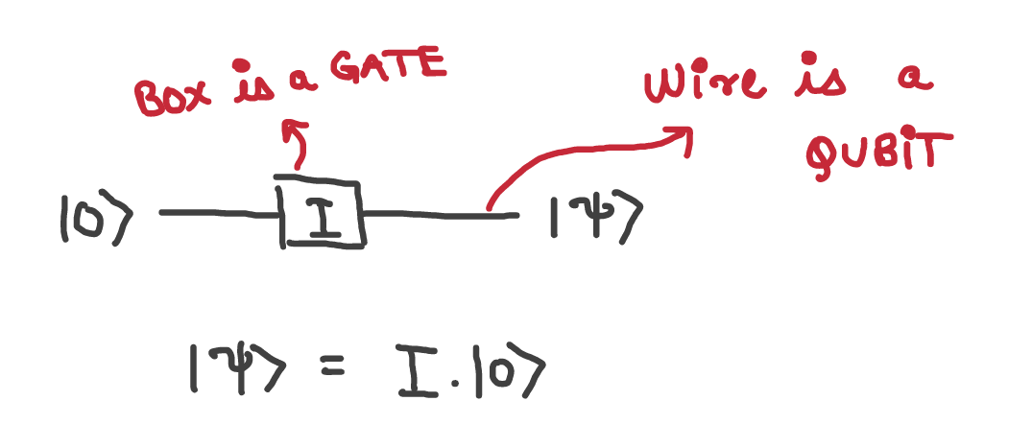
Starting Simple
Notes:
Any wire models a qubit whereas a gate is modelled by a box.
We apply gates to wires to change a qubit’s state from one to another.
But what about multiple qubits?

Slide 7
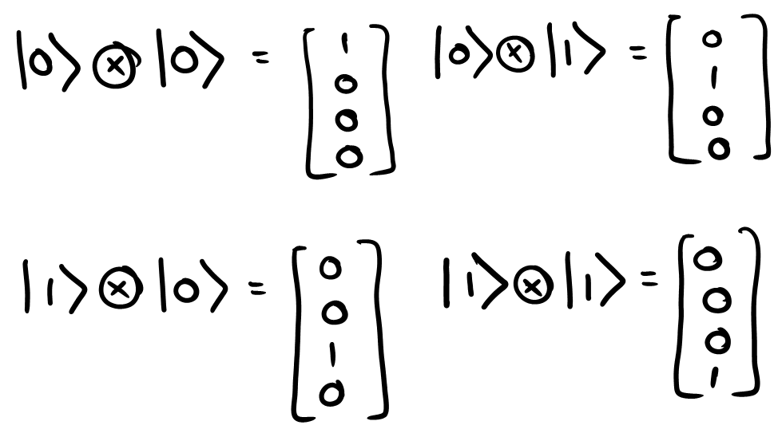
Review - Tensor Products
Notes:
For that, let's see a recap of the tensor products.
They are a great way to model ALL the combinations of a system and thus used for modelling interactions between multiple qubits.
This slide just shows a 2 - qubit basis states represented as a tensor product

Slide 8
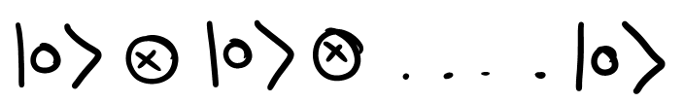
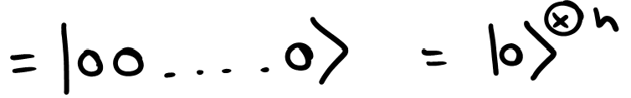
Review - Tensor Products
Notes:
The slide shows how we represent an n - qubit system.
With this background, let's see how we model this in the circuit model.

Slide 9
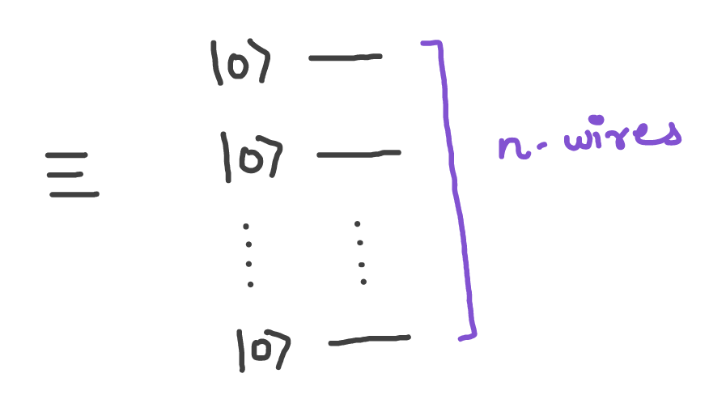
Multi - qubit states -> Multiple Wires
Adding a qubit => Adding a wire
Adding a wire => Tensor Product
Notes:
We use multiple wires stacked vertically to represent multi qubit systems.
Each wire represents a qubit
As we add up qubits to our system, we add corresponding wires too.
As we grow our wires, we will need an increasing number of tensor products to model the multi qubit system.
Let's take a step back and see the scale of this modelling.
If you say that each entry in a complex vector takes up 16 BYTES of memory
If we have a 32 qubit system, we will have a tensor product of size 2^32 i.e. 2^32 x 2^4 bytes
2^36 BYTES of memory would be required to model a 32 qubit system which is ~ 64 GB memory.
An average system would have a hard time modelling that, and some won't even be able to do it
That's where quantim computers show there power

Slide 10
Gates
We perform operations on the states of a quantum system using gates
Represented as boxes over wires
Notes:
Gates are operations which change a quantum state.
Since we represent states as wires, it makes sense to represent gates as Something which are acting on them
So gates are generally represented as boxes over wires.
They have names which represents there type and sometimes even parameter values.

Slide 11
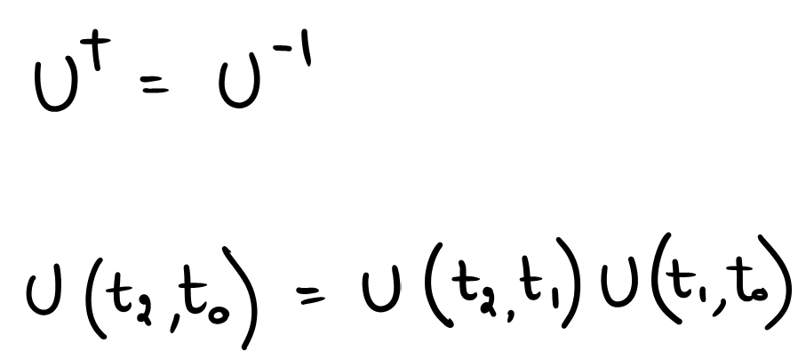
Recap
All quantum gates (operators) are Unitary matrices.
All quantum gates are reversible.
Multiple quantum gates can be stacked one after the other by simple matrix multiplication.
Notes:
Just to reiterate, the gates in quantum are unitary.
Which means they are self inverting, or U.U(dagger) = I
Besides this, composite operations, containing more than one operation on a system, can be clubbed together using matrix multiplication

Slide 12
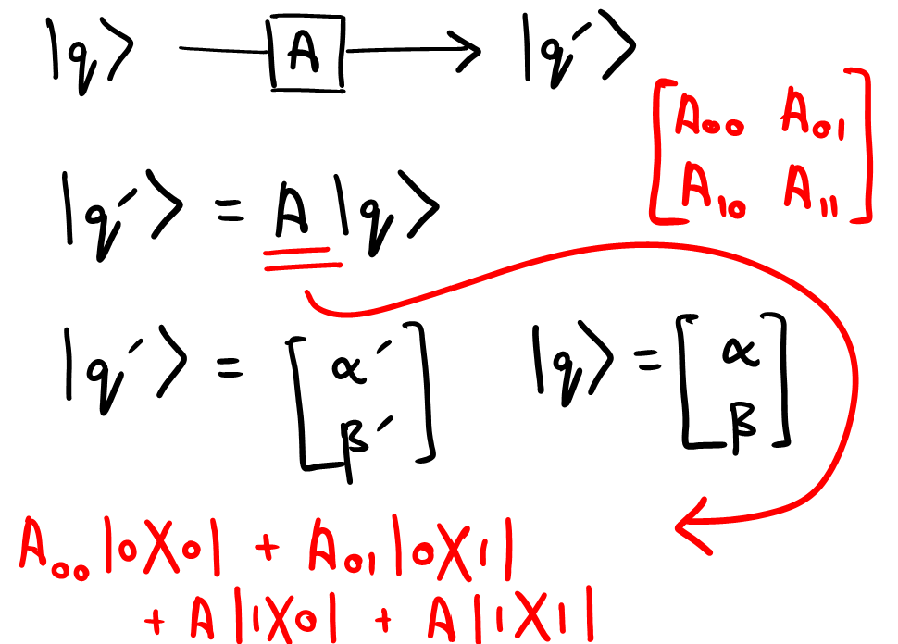
Recap
Notes:
This slide just highlights a single qubit gate operating on a qubit.

Slide 13
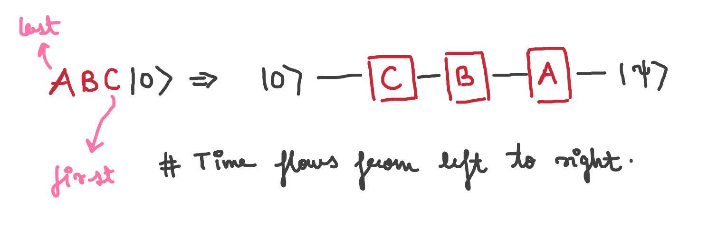
Single Qubits
Notes:
Lets see how the circuit model deals with single qubit gates.
Any general one qubit operation may contain multiple gates, such as
ABC |PSI>
This is modelled as the following circuit, where the closest gate is applied first to the qubit and then subsequent operations are applied.
Another thing to note is that time flows always from left to right

Slide 14
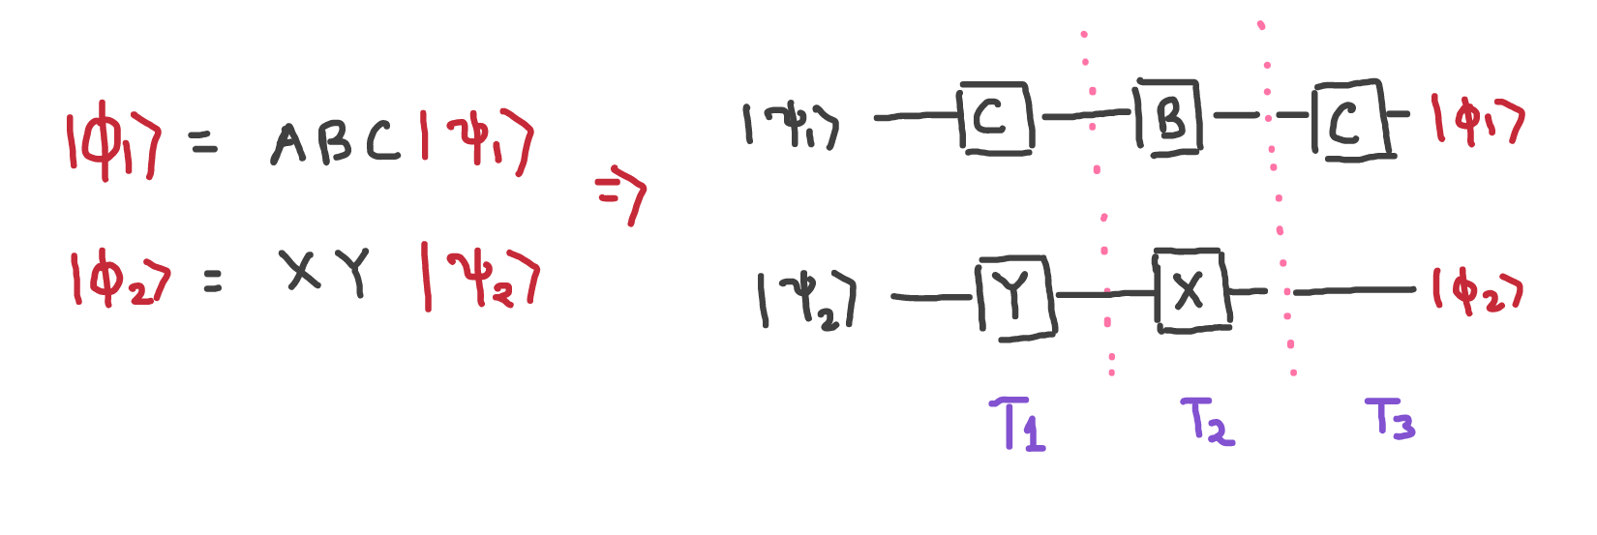
Multiple Qubits
Notes:
Modelling multiple qubits is just an extension of the how we model single qubits.
We saw how multiple wires represent multiple qubits, it can also be so that the wires contain gates.
The image shows how a 2 qubit circuit is modelled and you need to note that the gates are applied parallely to EACH qubit at the same depth.

Slide 15
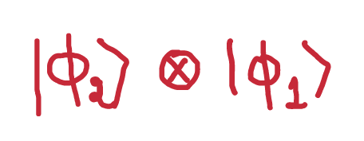
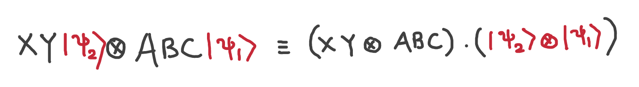
Multiple Qubits
Expanded
Notes:
This is the mathematical expression of the system and you can verify this equality by yourself taking some general values of the gates.
It just means that the tensor of the individual qubits in our final system is equivalent to the tensor the gate set applied to the initial system.

Slide 16
Measurements
In order to know the output of our computation we perform a measurement
Represented as meters over wires
Notes:
Here we have measurements
We saw that even though a qubit may exist on superposition, it will still collapse to either 0 or 1 when we interact with it
Only after interacting with it can we find some useful info.
This construct is represented as meters over qubit wires

Slide 17
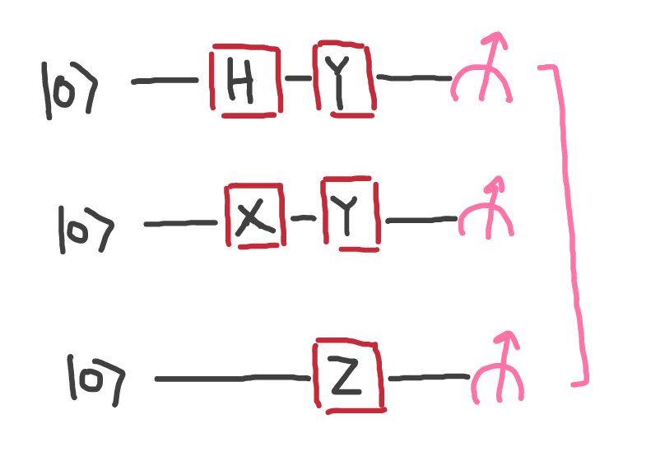
Measurements
At the end of our circuit, we would get one of the 2^n states i.e.
|000> or |001> or |010>, etc.
Need to run the circuit multiple times to get the distribution of results
Notes:
Here we see the representation of the measurements in the circuit model
Any measurement is happening over a qubit and the result is stored in a classical bit
Since any qubit will collapse into 0s or 1s we will have the result as one of the 2^n possibilities of these n qubits
A thing to note is that multiple runs or shots are gonna be required to find this distribution, as is the case when we want to find the probabilities of events.

